Slide 1
AWS – S3
April 2016

Slide 2
Version Sheet: MANDATORY (hidden in ‘slide show’ mode)
Version | Changes | Author
001 | Redesign | Rohan Salvi

Slide 3
Note to the SME:
Note to the SME:
This is a temporary slide and will not be part of the final upload at all. It is to help the SME understand how we will communicate changes to them.
Please read before you begin reviewing this module as SME
Dark Red box with white text
Note to the SME
The SME must provide missing info.
Amber box with black text
Note to the SME
The SME must validate the re-design/ the modification/ addition.
To Review and Navigate the comments in the presentation Click on the “Review” Tab and then Click “Next” to review all the comments . Also you can add your comments using the “New comment” button
The comments in the review section have also been updated in a green textbox with black text.
.

Slide 4
Ground Rules for Face-to-face Classrooms
Everyone participates
Respect individual opinions and diversities
Be open and honest
Give headlines, be concise
One speaker at a time
Make language a non-issue
Stick to time contracts
Seek first to understand, and then to be understood
Clean desk / room policy
No mobile phone,
No computer (except for surveys, polls etc)
Clients & Leadership are often around, please remember that
Maintain a spirit of fun and enthusiasm
Notes:
Best to print on an A3 sheet and display in class. The idea is to co-create, to connect to learn, to do-learn-do (knowing is not enough, the real purpose is to apply what we learn on the job). It would also be great to have the class share their learning with their teams. You are the facilitator, you will help all share knowledge and learn new concepts or skills, there will be no lectures, everyone is a teacher.

Slide 5

Ground Rules for Virtual Classrooms
Wait for others to finish speaking before you speak
Each time you speak, state your name
Build on others’ ideas and thoughts
Disagreeing is OK –with respect and courtesy
Participate actively in each session
Share experiences and best practices
Bring up challenges, ask questions
Discuss successes
Respond to whiteboards, polls, quizzes, chat boxes
Hang up if you need to take an urgent phone call, don’t put this call on hold
As a best practice…be just a few minutes early!
Communicate professionally with others
Mute when you’re not speaking
Be on time for each virtual session
Notes:
Show this slide and hide the one for onsite classrooms, if this is a virtual session.
ONLY for Virtual classrooms

Slide 6
Module at a Glance
SME to provide the details required in the table.
Target Audience:
Course Level: | Basic
Duration (in hours): | 30 mins
Pre-requisites, if any: | NA
Post-requisites, if any: | Submit Session Feedback
Relevant Certifications: | None

Slide 7
Introductions (for Virtual Classrooms)
SME to provide the photos and names of the facilitators.
Business Photo
Business Photo
Facilitator
Name
Role
Moderator
Name
Role
Notes:
Add pics and Capgemini roles for the Facilitator and moderator. Establish their credibility, what qualifies them to facilitate this session.

Slide 8
Course Map
What is S3?
1
What are S3 Essentials ?
2
S3 Basics
3
S3- Storage Tiers/Classes
4
S3 Pricing
5
Cloud Front
6

Slide 9


Module Objectives
Note to the SME : Please provide the module Objectives or validate the partially updated content
What you will learn
At the end of this module, you will learn:
What is S3
What you will be able to do
At the end of this module, you be able to:
Explain what is S3
S3 Essentials , Basics
Understand the S3 ,S3 – IA , S3- RR
Describe S3 Pricing
Describe Cloud Front

Slide 10
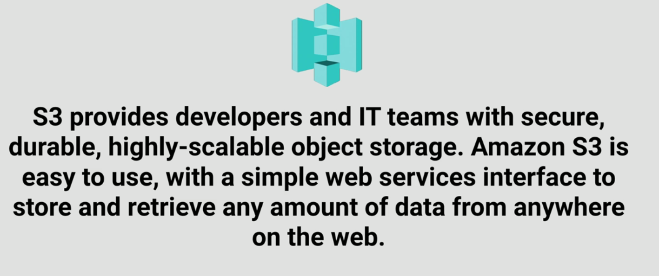
S3 Essentials - What is S3 ?

Slide 11

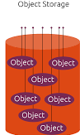

S3 Essentials
S3 is a safe place to store your files .
It is Object based Storage.
The data is spread across multiple devices
and facilities

Slide 12
S3- The Basics
S3 is object based i.e allows you to upload files .
Files can be from 1Byte to 5 TB
There is unlimited Storage .
Files are stored in Buckets
S3 is a Universal namespace , that is , names must be unique globally
https://s3-eu-west-1.amazonaws.com/acloudguru

Slide 13

S3 – The Basics
Read after Write consistency for PUTS of new Objects
Eventual Consistency for overwrite PUTS and DELETES ( can take time
to propagate )

Slide 14
S3 is a simple key , value store
Key – name of the object
Data and sequence of bytes
Sub resources
Access control lists
Metadata
Version id

Slide 15





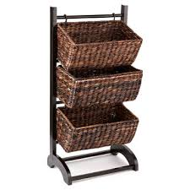

S3 Basics
Tiered Storage Available

Slide 16





S3 Basics
Lifecycle Management

Slide 17

S3 Basics
Using Access Control Lists & Bucket Policies

Slide 18
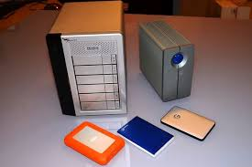

S3 – Storage Tiers / Classes
99.99 % availability ,99.99999999999% durability
Redundant storage across multiple devices
Accessed less frequently , lower fee than S3
99.99% availability,99.99%
durability over a given year
Very Cheap , used for Archival only
S3
S3 - IA
S3- RRS
Glacier

Slide 19
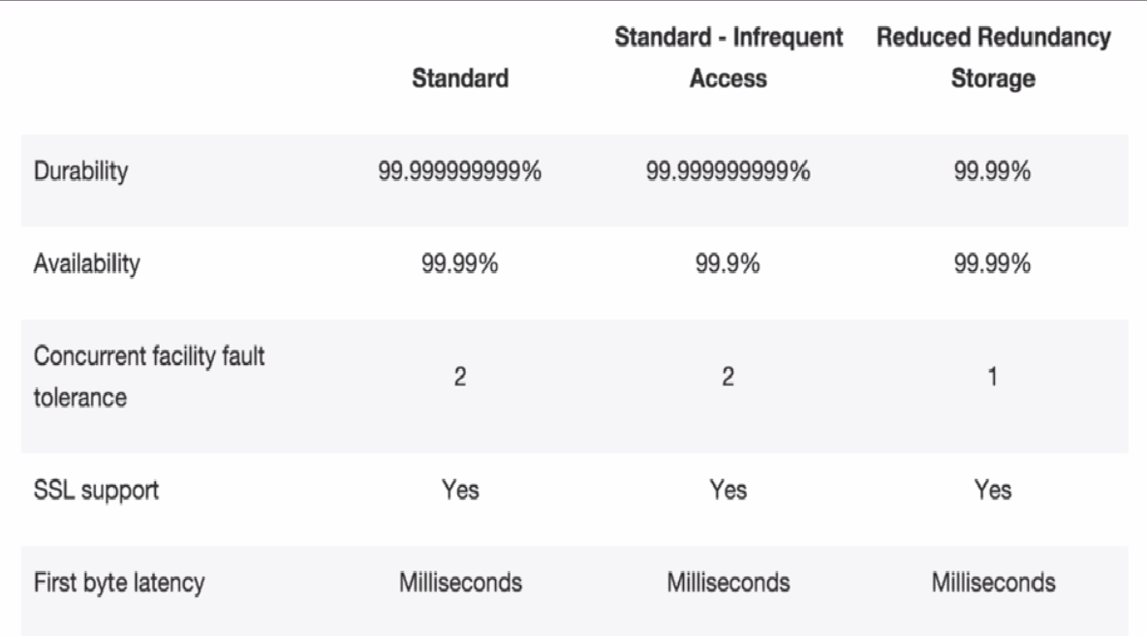
S3 –Storage Tiers/Classes

Slide 20
S3 - Charges
Charged for
Storage
Requests
Data transfer Pricing

Slide 21
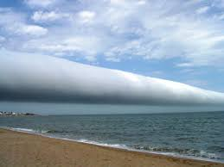
Cloud Front

Slide 22



CDN – Content Delivery Network
System of distributed servers that deliver web pages and web content to user
Based on Geographical locations

Slide 23
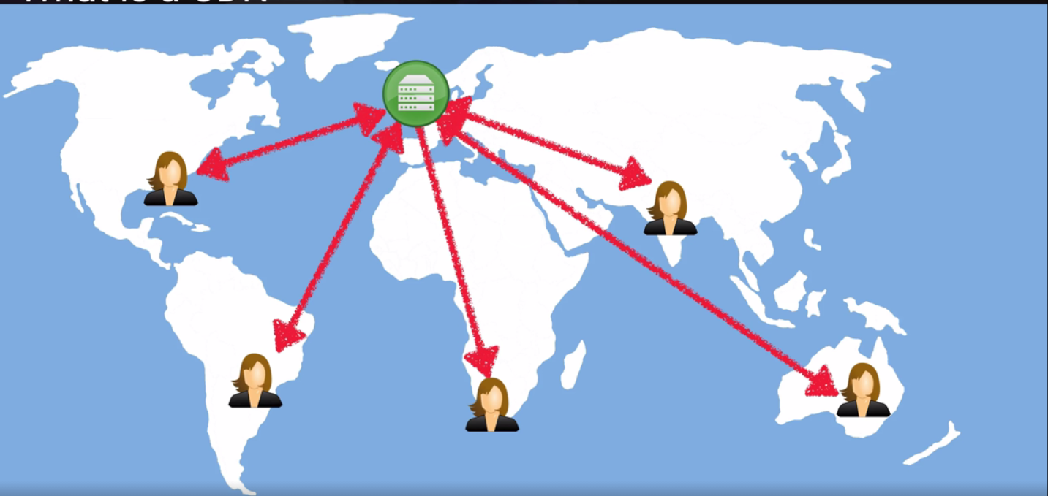
What is CDN ?

Slide 24

Cloud Front – Key Terminology
Origin - of all files
Edge Location – Content is cached
Distribution – consists of edge locations

Slide 25
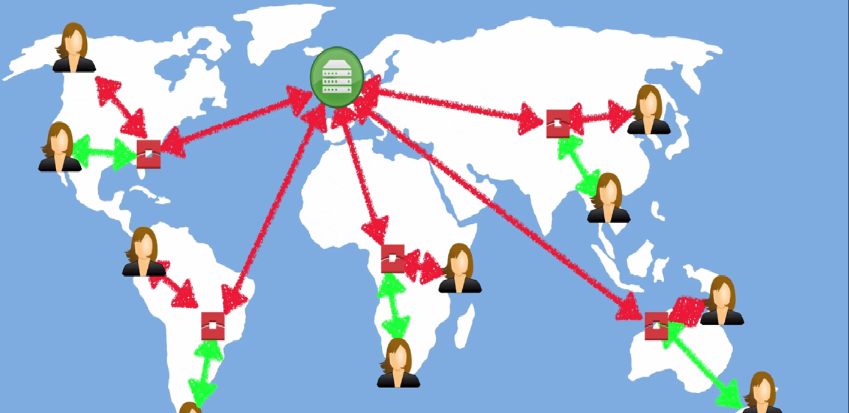
What is a CDN ?

Slide 26

What is Cloud Front ?
Content
Dynamic
Amazon cloud front
Streaming
Static
Interactive

Slide 27
Cloud Front – Key Terminology
Web Distribution - Used for Websites
RTMP – Media Streaming

Slide 28
Summary
Learnt what is S3
S3 Essentials
S3- The Basics
S3 , S3 –IA , S3 - RR
S3 Pricing
Cloud Front

